Slide 1
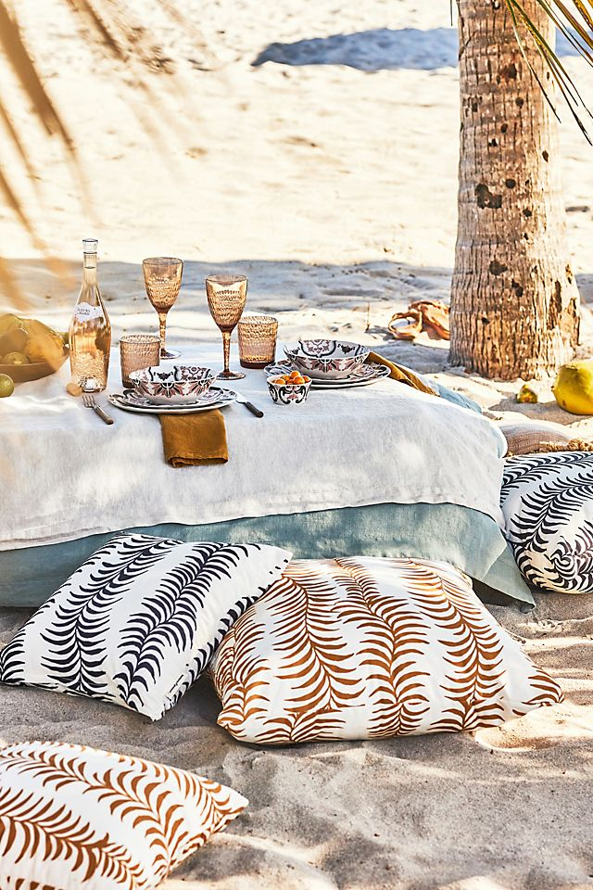
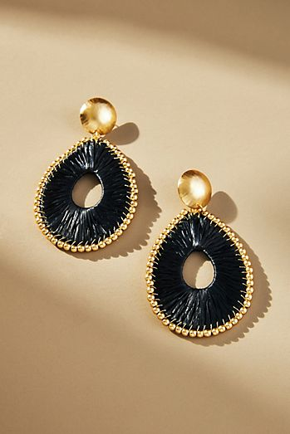
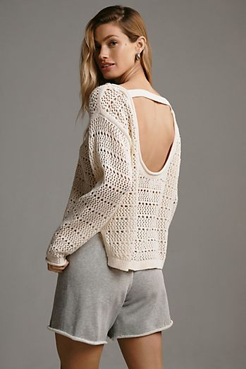
RETAIL BRAND: ANTHROPOLOGY

Slide 2
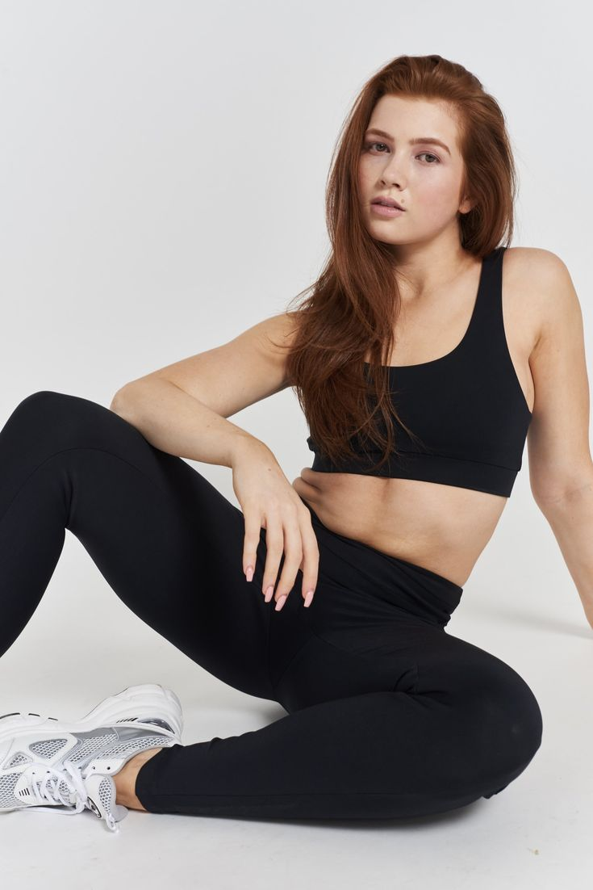
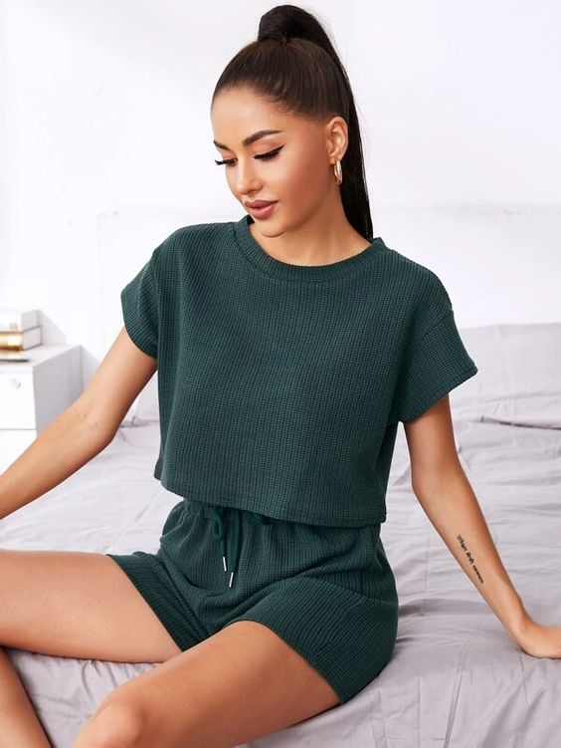
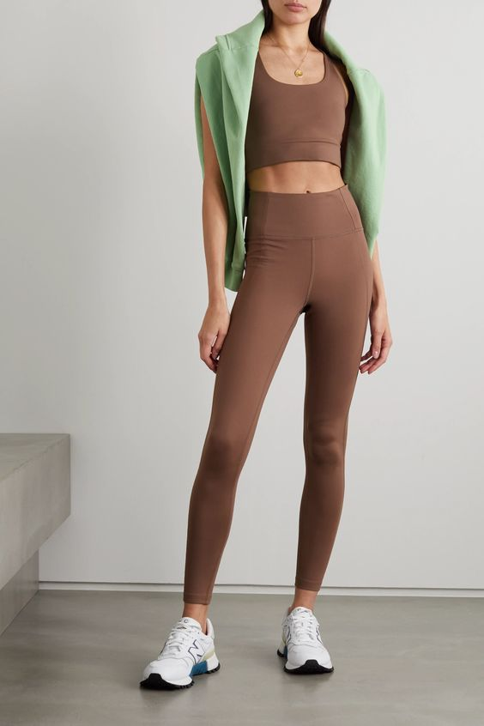
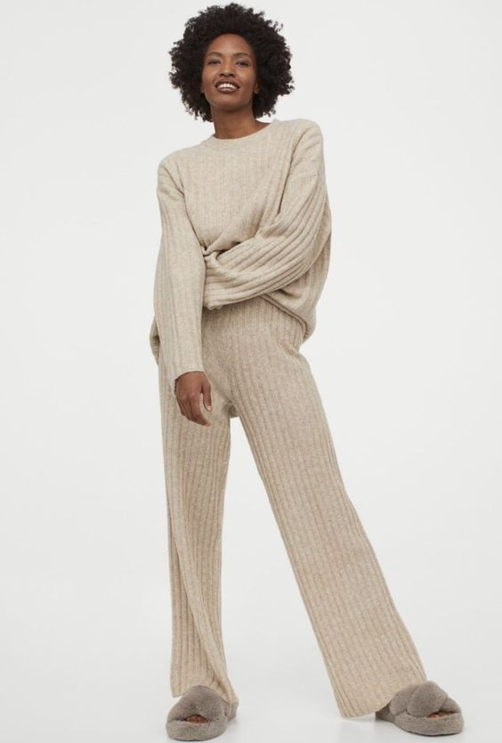
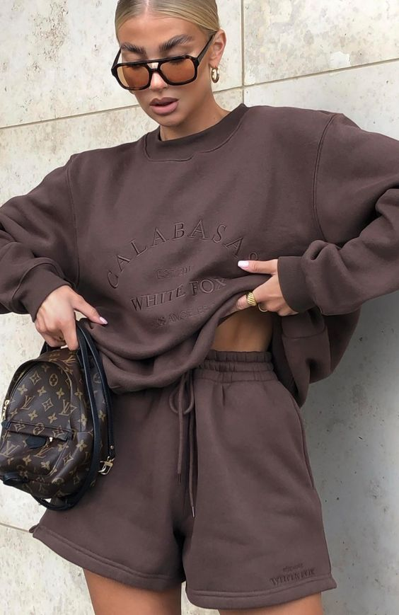
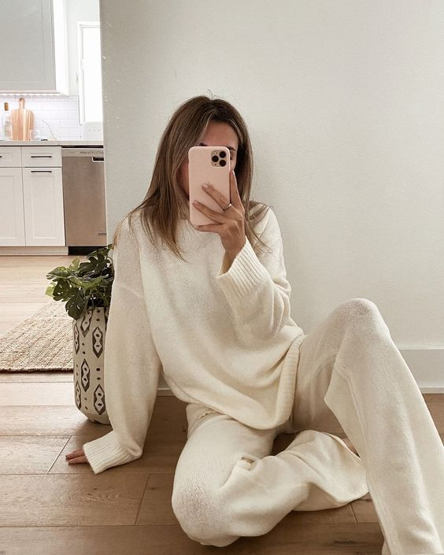
Collection ranges from: leggings, sweatshirt, lounge wear, shorts, oversized two piece

Slide 3
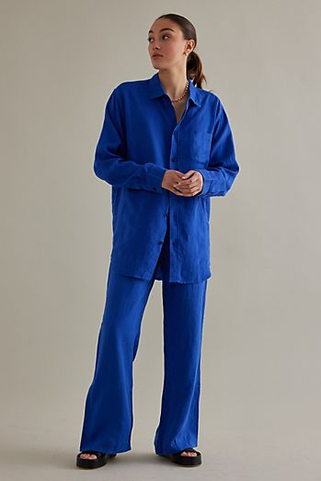
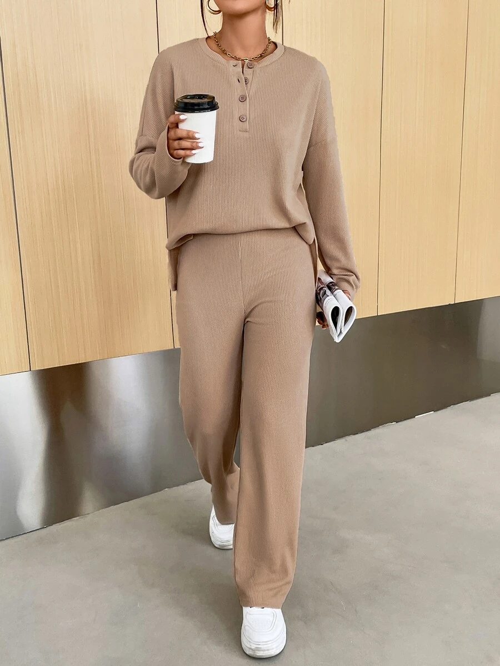
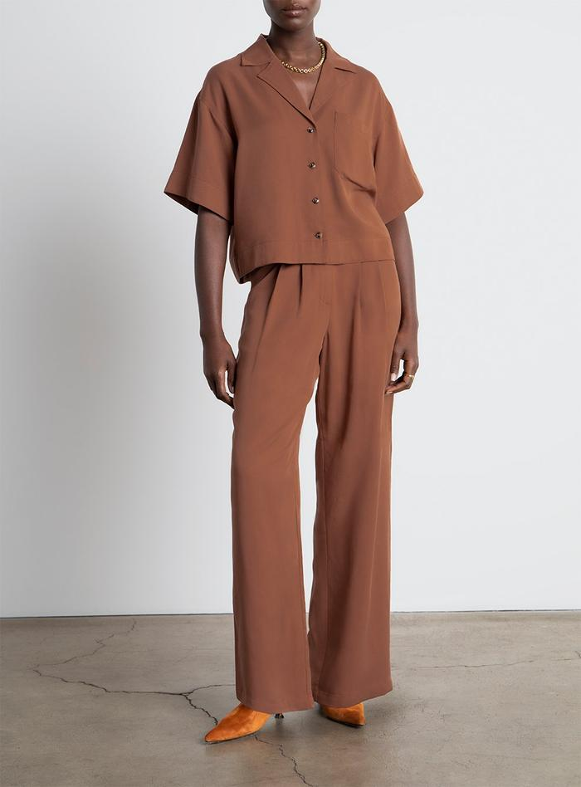
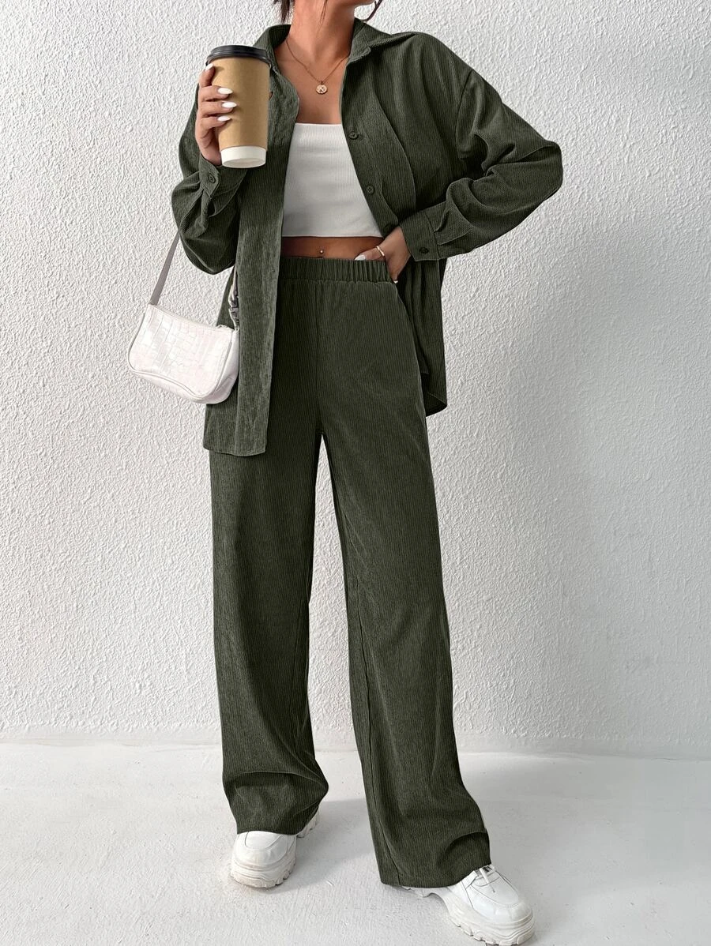
THEME: Work Leisure Wear

Slide 4
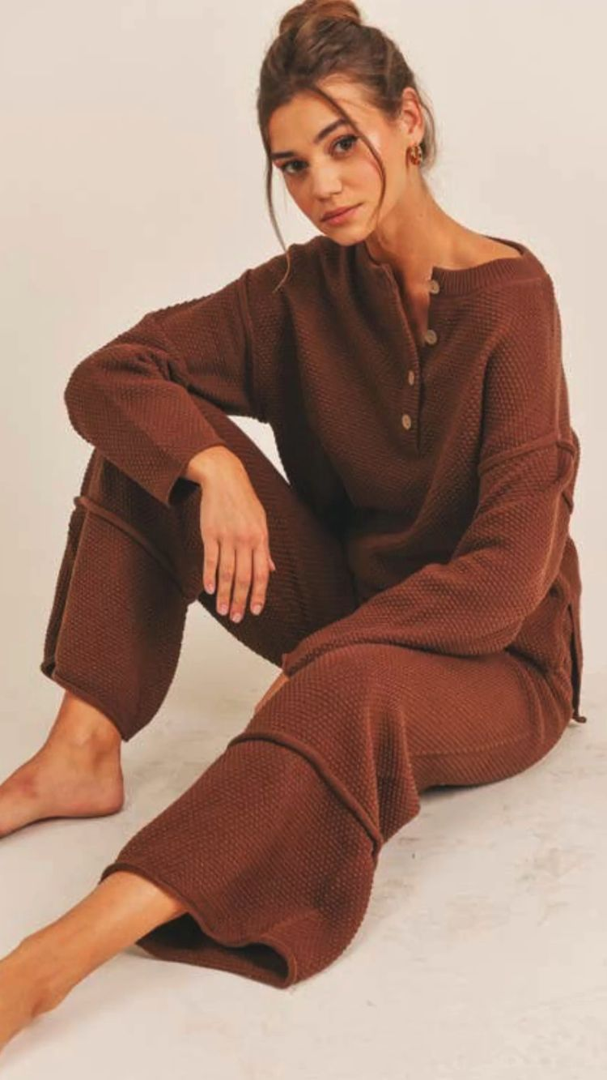
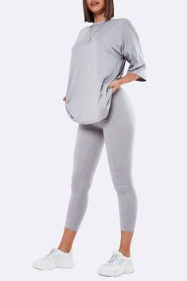
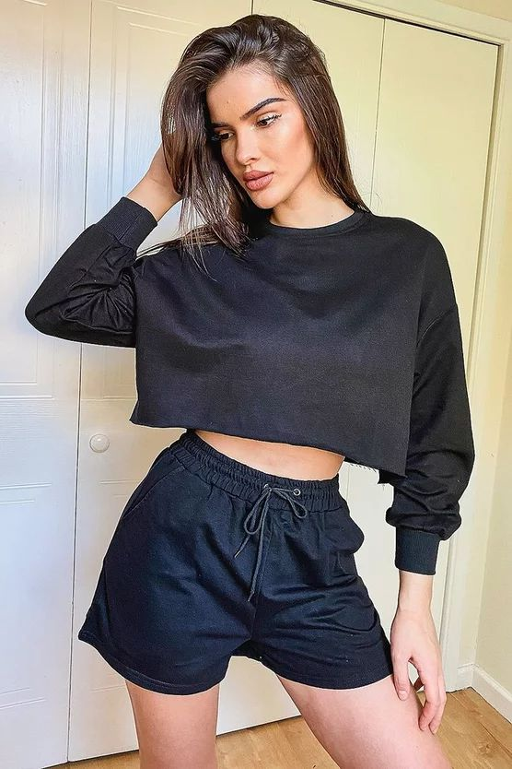
Comfort is key

Slide 5
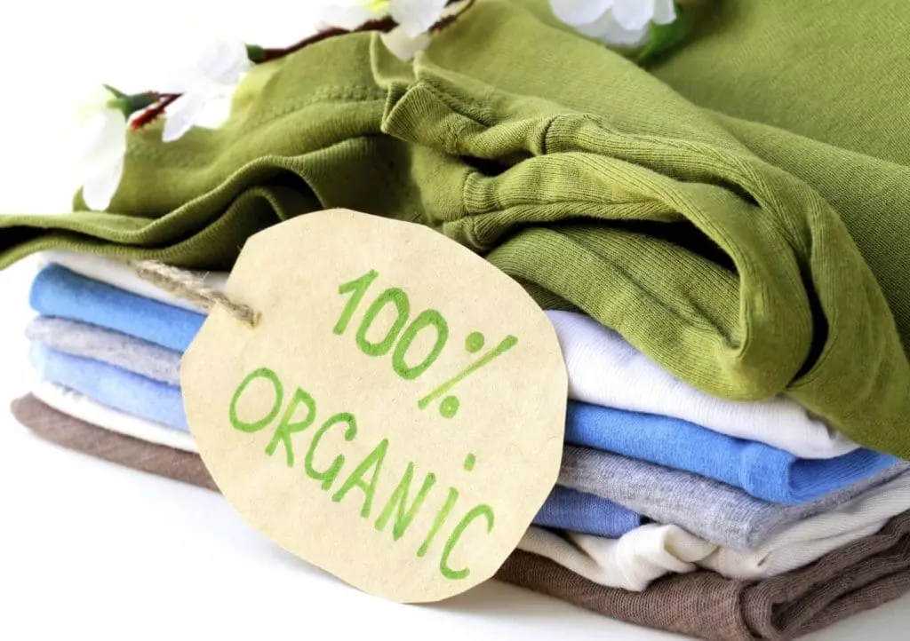

COLLECTION NAME :
GREEN AND COMFORT

Slide 6
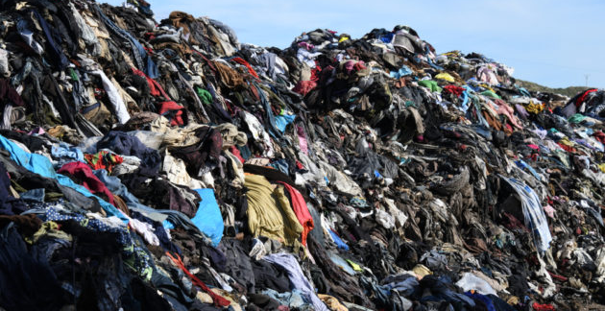

Slide 7
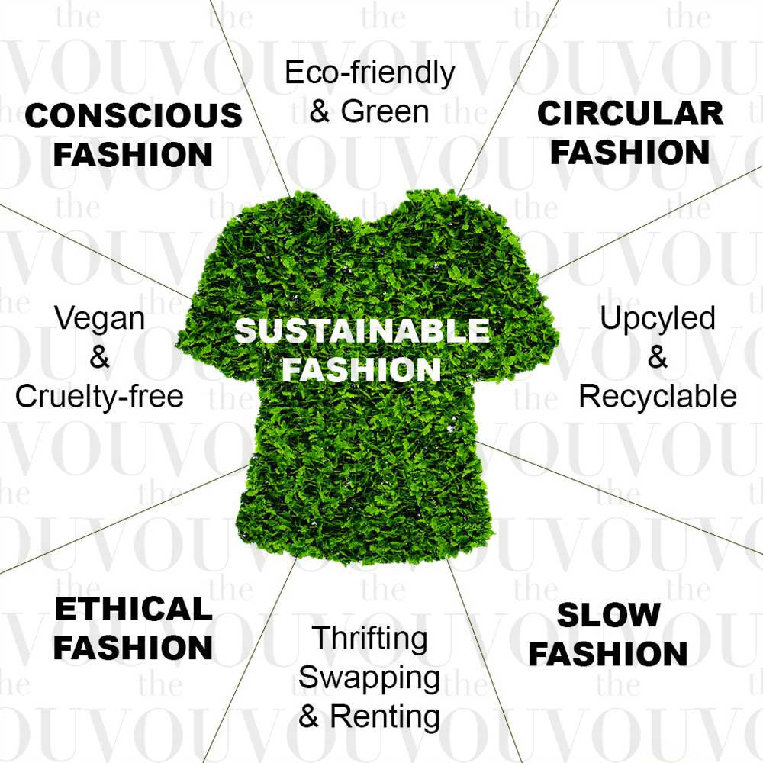

Slide 8


Slide 9


Slide 10


Slide 11
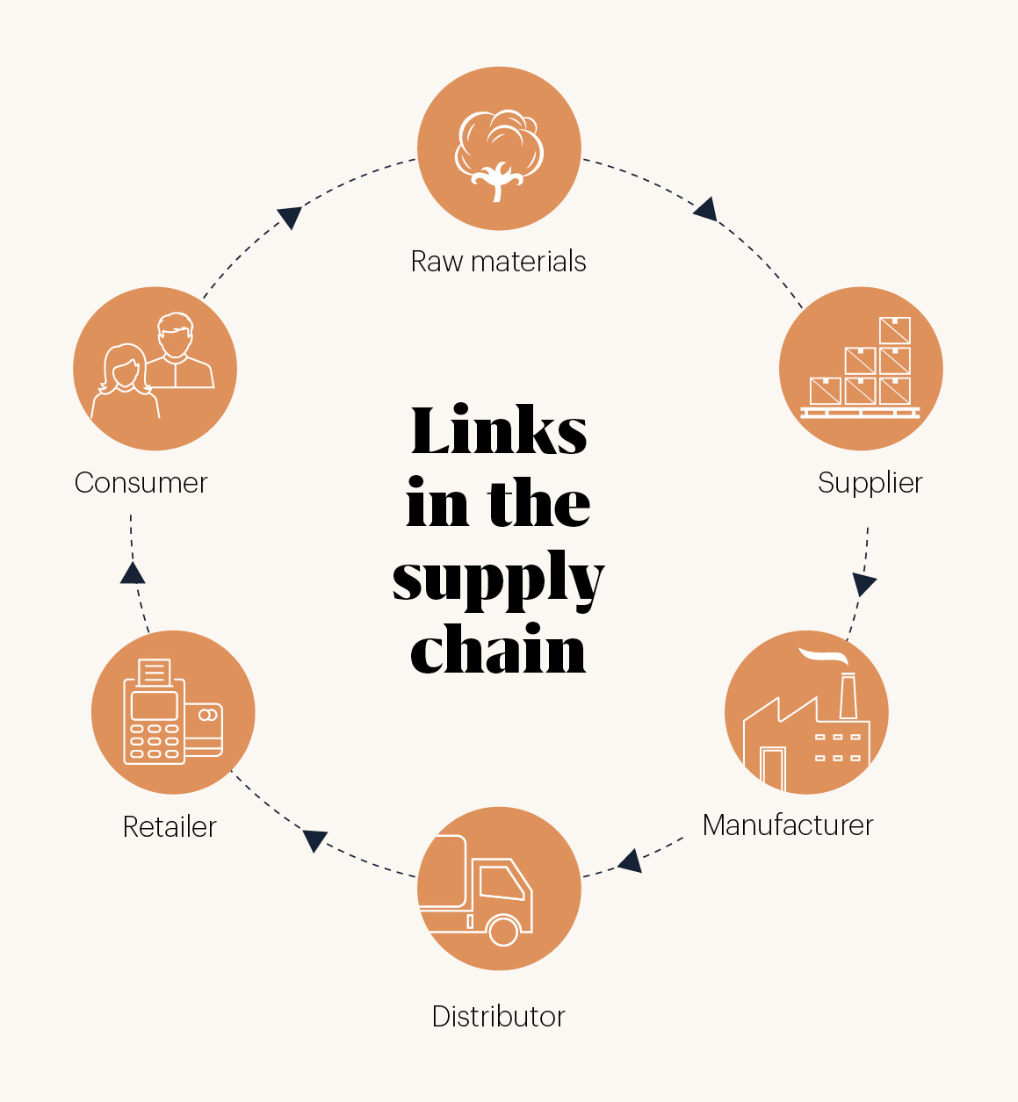
Supply Chain Strategy

Slide 12




SUSUTAINABLE TEXTILE AND FABRIC SUPPLIER TO PARTNER WITH

Slide 13

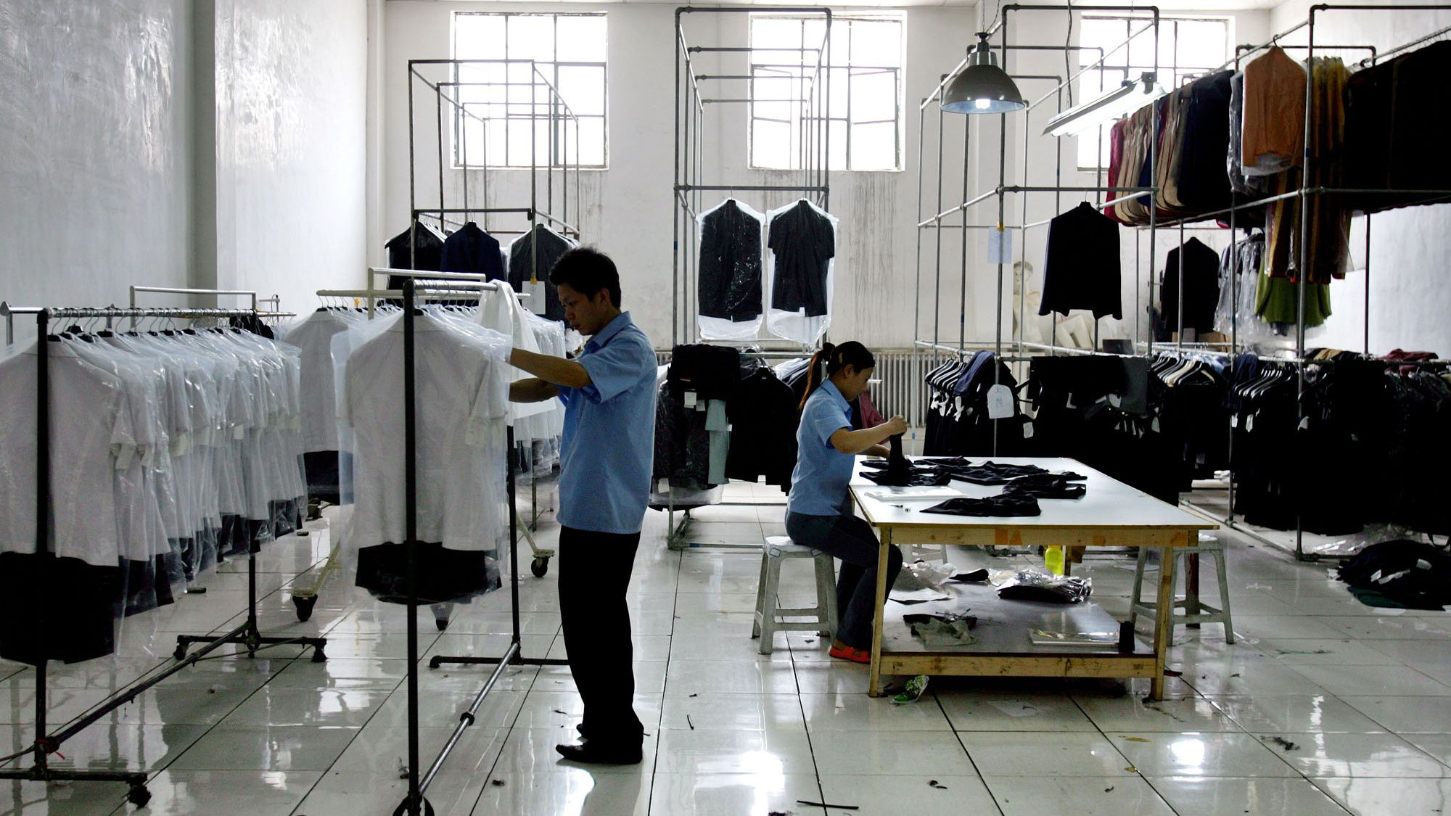

SUSTAINABLE CLOTHING MANUFACTURING BRAND TO PARTNER WITH
BAXTER HOUSE

Slide 14


SUSTAINABLE DISTRIBUTION BRAND TO PARTNER WITH
PACKHELP
DHL GoGreen

Slide 15
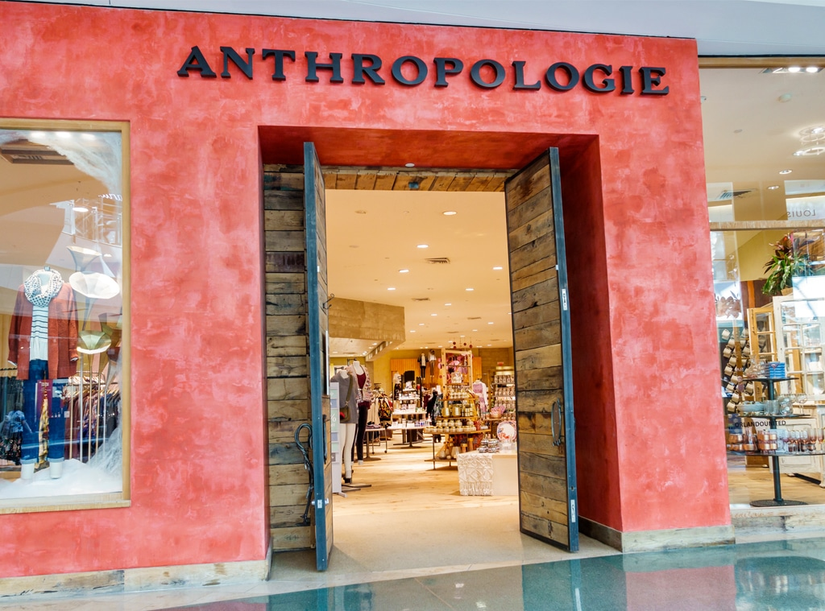
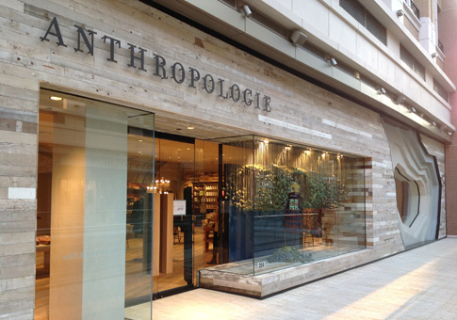
RETAIL BRAND COLLABORATION
Partnering with Anthropologie as a retail brand to showcase new collection and to have a platform for the target customers

Slide 16
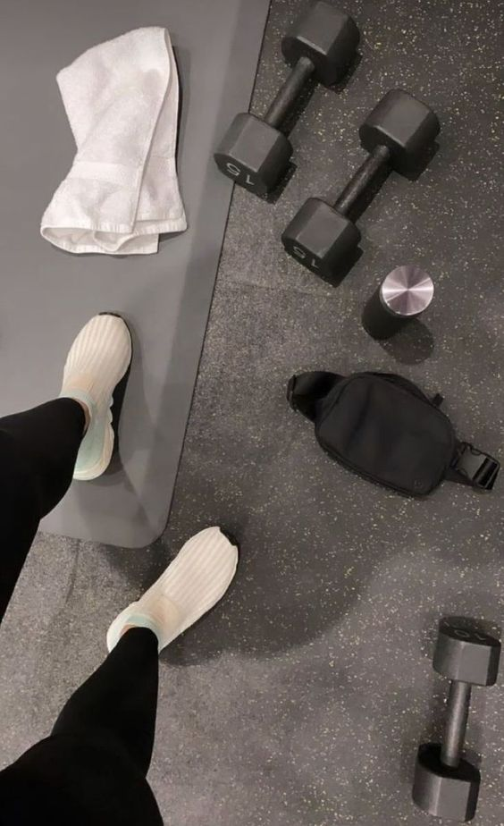
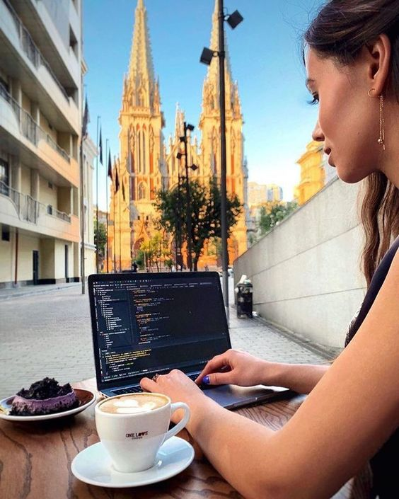
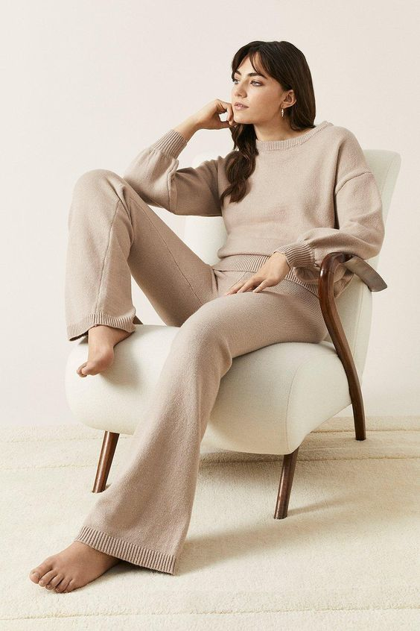
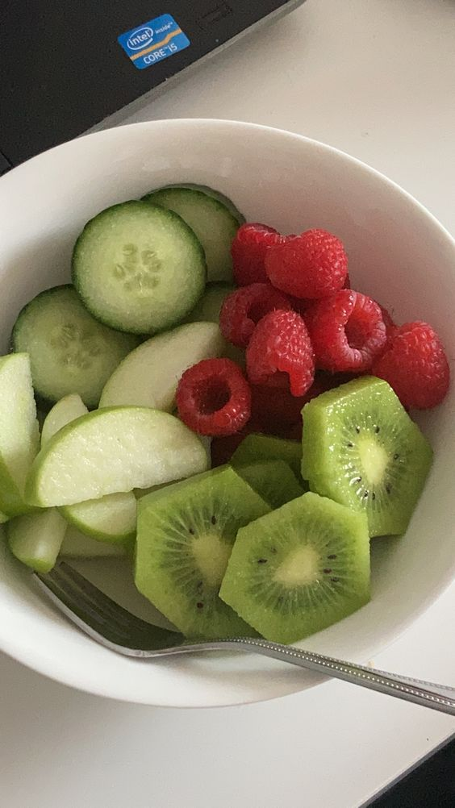
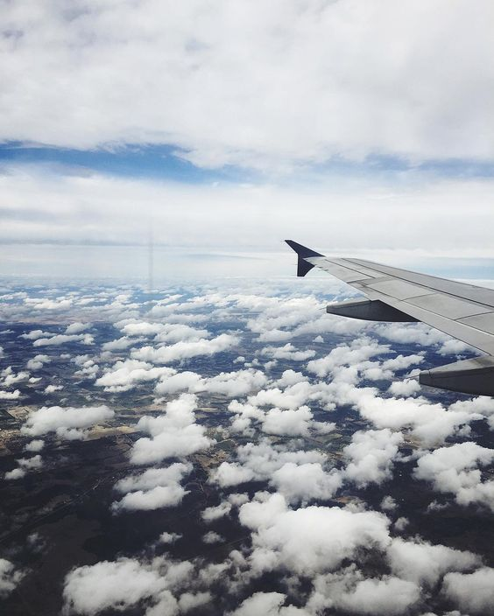



CUSTOMER PROFILE
Joan Andrew
Age 26
Digital Marketing
Remote worker
Lives in the city
Fashion conscious, fitness and health, sustainability, nature lover, loves to travel. Social media
Salary: 40-55k p/a
Brands: PANGAIA

Slide 17


MARKETING STRATEGY
SOCIAL MEDIA PLATFORMS
SOCIAL MEDIA INFLUENCERS

Slide 18
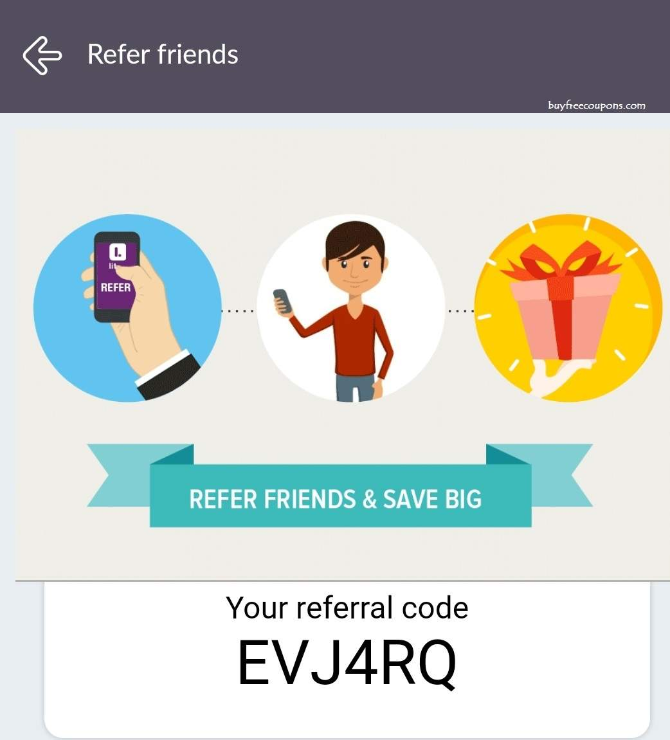

MARKETING STRATEGY
Pop-up sales
Discount sales
Referral code

Slide 19


Slide 20
Reference list
https://cardblaze.com/wp-content/uploads/2017/08/anthropologie.jpg
https://memberpress.com/wp-content/uploads/2019/10/Choosing-platforms@2x-1024x683.png
https://www.buyfreecoupons.com/wp-content/uploads/2019/03/screenshot.jpg
https://www.google.com/url?sa=i&url=https%3A%2F%2Fwww.slheatons.org%2F2022%2F02%2F05%2Ffashion-and-sustainability-really%2F&psig=AOvVaw04mbVe6JjESHet3PahPT3p&ust=1681818245048000&source=images&cd=vfe&ved=0CBAQjRxqFwoTCNjn86rrsP4CFQAAAAAdAAAAABAf

Slide 21
REFERENCE LIST
https://theveganreview.com/wp-content/uploads/2021/03/RecycledPlasticClothing3-630x420.jpg
https://vermontrepublic.org/wp-content/uploads/2020/06/clothes.jpg
https://stpaulsmaumee.org/wp-content/uploads/2019/11/fash-fashion-1080x675.jpg
https://i.pinimg.com/originals/3e/41/05/3e4105bbce8aa0810690c9d6500bf13f.jpg
https://cdn.shopify.com/s/files/1/1118/7596/articles/shutterstock_319121309.jpg?v=1526024552

